Slide 1
AI Agent for Personalized Stock Trading and Market Advisory
Presented by:
Fluffy Debuggers (T11) B.Tech CSE (AIML & IoT) – GLA University
Team Members:
Nakul Upadhyay
Priyam Kumar
Yuvraj Upadhyay
Mentor:
Mr. Preshit Mangesh Desai

Slide 2
Problem Statement
Retail investors struggle to make informed trading decisions
Market data is fragmented across multiple platforms
Information overload leads to confusion
Existing platforms focus on execution rather than guidance
Need for personalized and explainable advisory system

Slide 3
Objectives & Project Overview
Goal
Develop an AI-powered system providing personalized buy/sell/hold recommendations.
Objectives
Analyze historical and real-time stock data.
Integrate news and sentiment analysis.
Provide risk-aware recommendations.
Improve decision-making using AI insights.

Slide 4
Technical Approach
Data collection from stock market APIs and news sources
Data preprocessing and feature extraction
Machine learning models for prediction
NLP-based sentiment analysis
AI generates recommendation with confidence score
Results displayed through dashboard

Slide 5
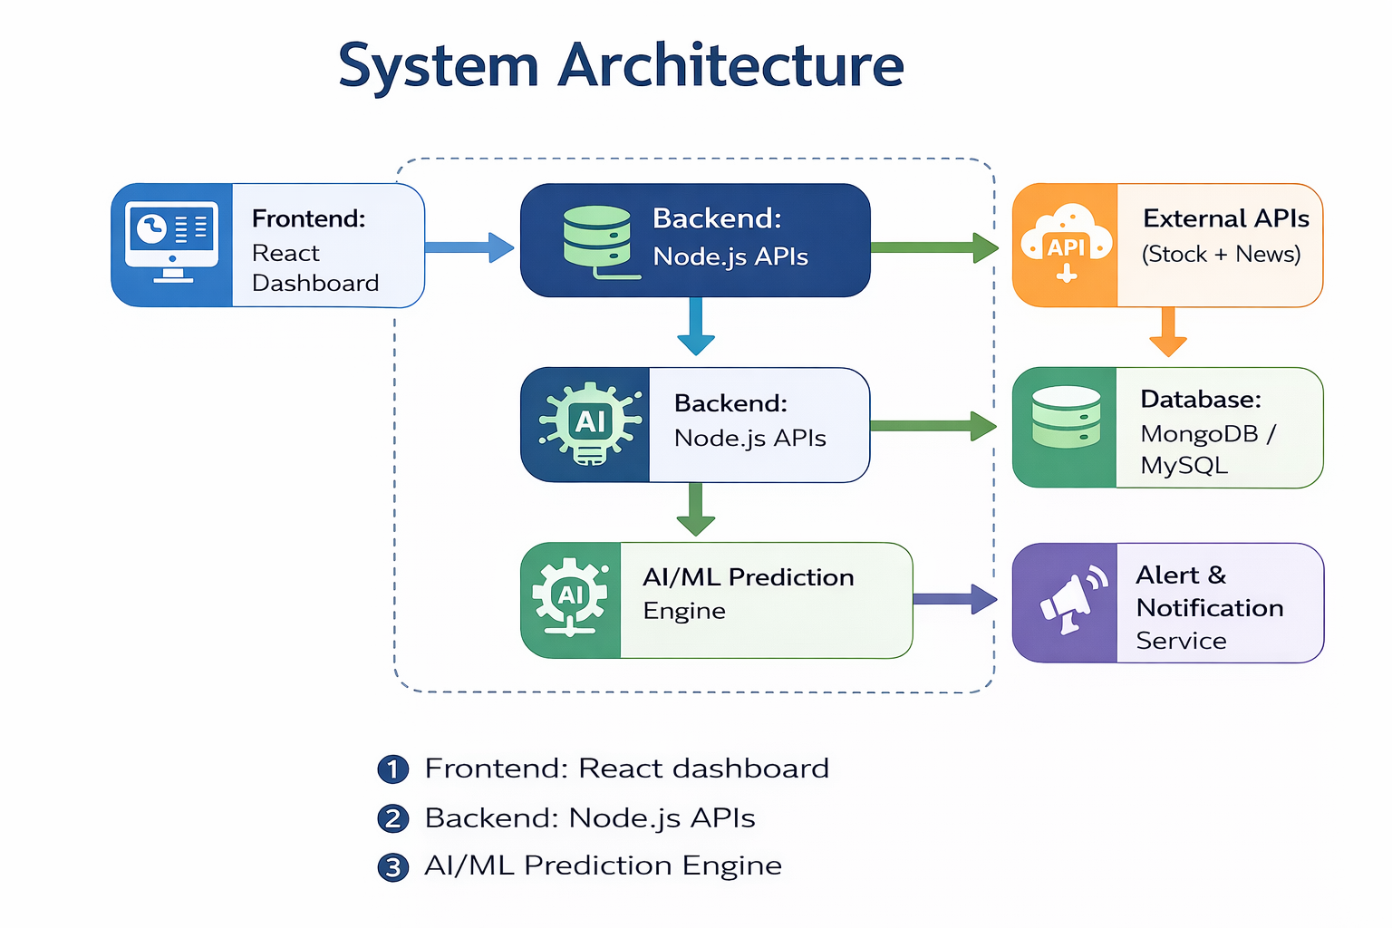
System Architecture

Slide 6
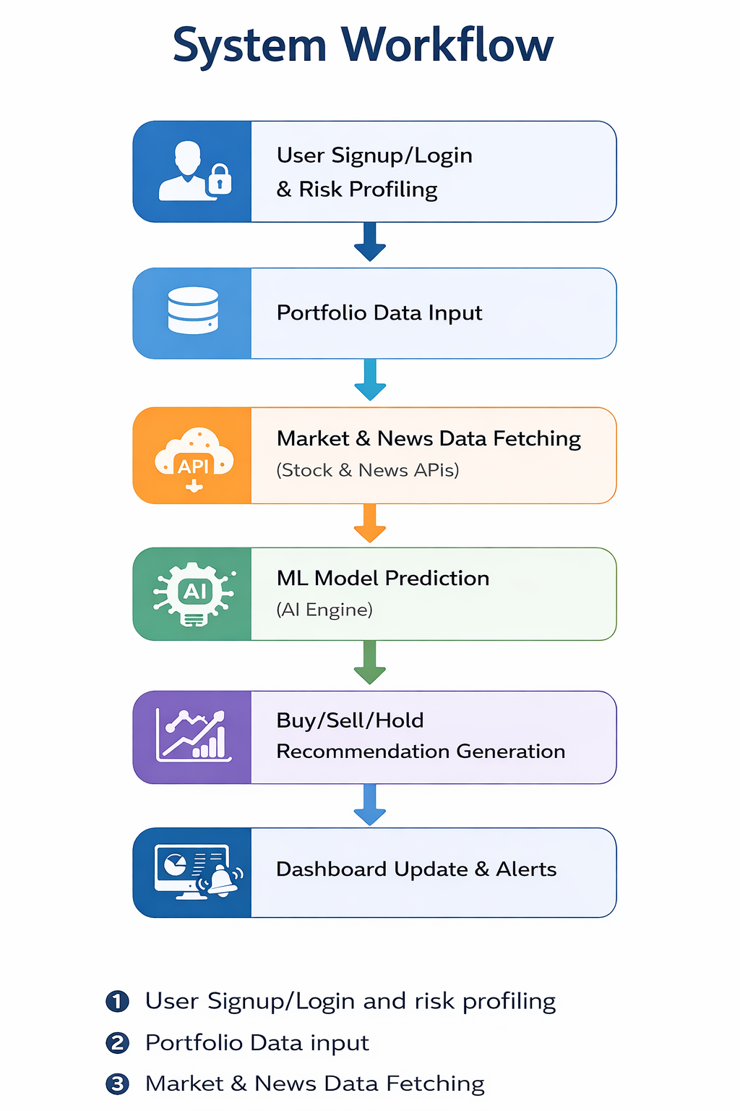
System Workflow

Slide 7
Key Features
AI-based stock recommendations
Portfolio visualization dashboard
Personalized risk assessment
Real-time alerts
News sentiment analysis
AI confidence score
Paper trading simulation

Slide 8
Uniqueness & Innovation
Personalized AI recommendations based on risk profile.
Confidence score for explainable AI decisions.
Integration of market data + sentiment analysis.
Educational decision-support system (not automated trading).
Real-time analytics with simplified visualization.

Slide 9
Weekly Project Timeline
Week | Activity
1-2 | Requirement analysis & architecture design
3-4 | Backend & frontend setup
5 | ML model development
6 | AI integration
7 | Testing & optimization
8 | Deployment & presentation

Slide 10
Team Member Contributions
Nakul Upadhyay | Priyam Kumar | Yuvraj Upadhyay
Frontend development | Backend APIs | ML model development
UI/UX design | Database design | Data preprocessing
Integration & reviews | Authentication & security | AI integration & evaluation

Slide 11
Results, Quality & Testing
AI prediction accuracy target ≥ 80%
API response time ≤ 1200 ms
System availability ≥ 99%
Unit testing, API testing, and ML validation performed.
Integrated testing before deployment.

Slide 12
Conclusion & Future Scope
Conclusion
AI-based advisory platform simplifies investment decisions.
Combines ML predictions with sentiment insights.
Provides personalized and explainable recommendations.
Future Scope
Advanced deep learning models (LSTM/Transformers)
Mobile application support
Improved personalization
Integration with more financial datasets

Slide 13
THANK YOU

